Slide 1

Victorian State Schools
Voluntary Parent Payments (2022–2024)
A Data Analytics Case Study
Aayush Ketan Purohit | Student ID: 1850846
DATA6000 – Capstone: Industry Case Studies

Slide 2
The Challenge: Funding Inequity
Unpacking Voluntary Parent Contributions
Our core investigation seeks to understand the dynamics of voluntary parental contributions within Victorian state schools between 2022 and 2024. The primary goal is to identify how these contributions vary across different locations and, crucially, how these variations impact funding equity among schools.
Regional Inequity
Metro vs Regional Inequity
Small School Constraints
Metropolitan schools consistently raise significantly more funds compared to their regional counterparts, creating a clear geographical disparity.
Between 2022 and 2024, Metropolitan schools raised two to three times more in voluntary contributions than Regional schools, creating a clear resource gap.
Schools with lower student enrolments face inherent limitations in their capacity to generate significant voluntary funds, irrespective of their community's socio-economic status.

Slide 3

The Foundation: Data Sources
Comprehensive Data for Robust Analysis
To provide a holistic view of parent contributions and their impact, we leveraged a diverse set of reliable data sources. These included direct financial data, socio-economic indicators, and broader educational reports.
Key Datasets
Victorian State Schools Voluntary Parent Payments
(2022–2024)
Australian Bureau of Statistics (ABS) regional income profiles
Department of Education reports on funding models
(Annet, 2024).
Data Coverage & Scope
Our analysis focuses on school-level aggregated data across specific categories of contributions: Subject Contributions, Class Materials, Fundraising, Donations, and Camps/Excursions, spanning the 2022–2024 period to capture recent trends.

Slide 4
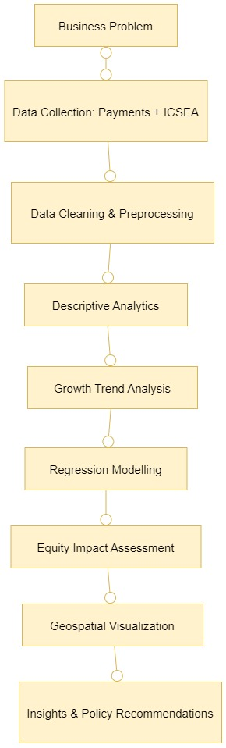
Our Analytical Journey
Methodology Flowchart: From Problem to Policy
Our analytical approach followed a structured methodology, designed to move from initial problem
identification to actionable policy recommendations.
Analytical Approaches Applied
Descriptive Statistics: Summarizing key characteristics of the data
(Cooksey, 2020).
Trend Analysis: Examining year-on-year changes in contributions.
Regression Modelling: Quantifying relationships between region, school size, and contributions.
Geospatial Visualization: Mapping regional funding disparities using Power BI.

Slide 5
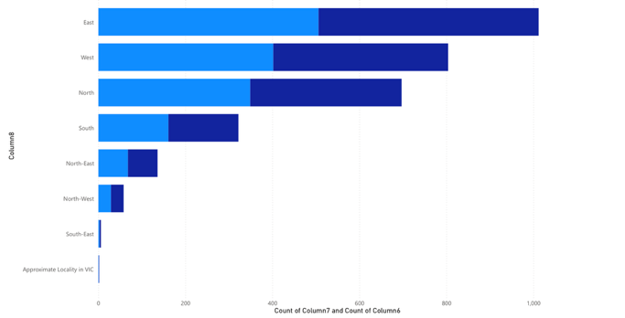
Initial Findings
Descriptive Insights: The Urban-Rural Divide
Analysis of average annual contributions revealed a stark disparity between metropolitan and regional schools, highlighting
a persistent urban-rural divide in funding.
Key Observation: Metro East & South consistently demonstrated the highest average contributions, while Regional North & West reported the lowest. Total voluntary contributions increased steadily between 2022 and 2024.

Slide 6
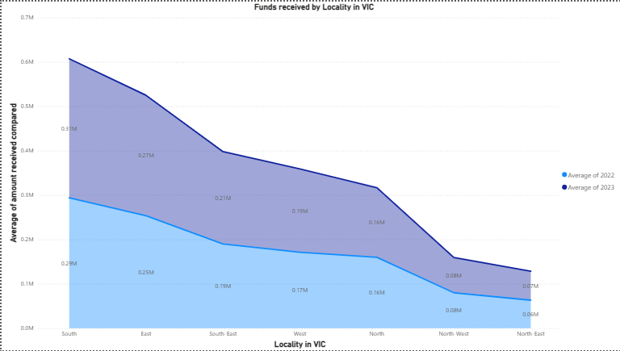
Tracking the Trajectory
Trend Analysis: A Widening Equity Gap
A deeper dive into year-on-year changes in contributions revealed concerning trends, particularly the widening disparity between urban
and rural school funding.
Funding Growth Patterns: Metropolitan regions exhibited steady and consistent year-on-year growth in voluntary contributions (Doorudinia et al., 2025). In contrast, regional schools showed minimal to no growth during the same period. This divergence suggests that the equity gap is actively widening over time.
Implication:
Without timely and strategic policy intervention, the existing resource inequality across Victorian state schools is projected to continue its upward trajectory, potentially entrenching disadvantage for regional students.

Slide 7
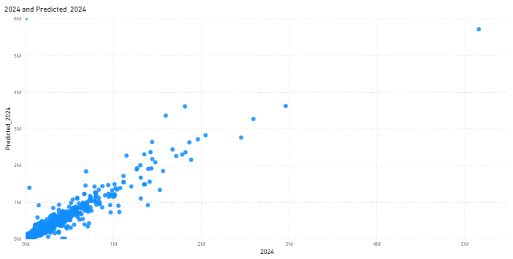
Predicting Contributions
Predictive Modelling: Uncovering Key Drivers
To quantify the influence of various factors on voluntary contributions, we employed regression modelling.
This allowed us to identify the most potent predictors of funding levels.
Regression Findings:
Region: Metropolitan schools consistently raise significantly more funds than regional schools, even when controlling for other variables.
School Size: Larger student enrolments correlate with higher overall contribution totals, likely due to a broader donor base.
Quantitative Outcome:
Our model achieved a high R² value, explaining a substantial majority of the variance in contribution levels. This demonstrates that voluntary contributions can be predicted with reasonable accuracy using a combination of regional indicators, and school size.

Slide 8
Assessing Our Model
Evaluation: Performance and Limitations
Our model demonstrated robust explanatory power, but it's important to acknowledge its inherent limitations and the factors not fully captured within the scope of this analysis.
Model Performance
Limitations
R² Value
Data Timeframe: Analysis ends in 2024, limiting insights into long-term trends post-COVID recovery and subsequent economic shifts.
0.926
Approximately 92.6% of variance in contributions explained
by the model.
Self-Reported Data: Voluntary contributions are often self-reported by schools, which may introduce variability in accuracy and reporting standards (Gao et al., 2021).
MAPE Value
44.6
External Shocks: The model doesn't fully account for the impact of unforeseen external economic shocks (e.g., high inflation, future policy shifts) that could influence parental capacity to contribute.
Mean Absolute Percentage Error of approximately 44.6%, indicating high average accuracy.

Slide 9
Impact and Insights
Significance & Reflection: Informing Policy
The findings underscore the critical need for policy intervention to address ingrained inequities in school funding.
Business Significance
Reflection on Process
Regional Inequity: Persistent disparities risk cementing educational disadvantage for students in regional areas, impacting their long-term outcomes.
Visualisation Clarity: Engaging with peer feedback significantly improved the clarity and impact of our data visualisations.
Small Schools: These schools require tailored support to overcome their inherent fundraising limitations and ensure they can offer comparable educational opportunities.
Regression Depth: The regression analysis provided invaluable depth, moving beyond mere description to quantify causal relationships.
Policy Advocacy: The robust findings strengthened the case for targeted policy intervention to promote equitable funding.

Slide 10
Conclusion
Our analysis reveals a clear and widening disparity in voluntary parent contributions across Victorian state schools, fundamentally challenging the notion of equitable funding.
Key Takeaways:
Voluntary contributions are not distributed equitably, with significant geographical and socio-economic biases.
The funding gap widened between 2022 and 2024, indicating a growing problem.
Policymakers must act decisively to implement mechanisms that balance support and ensure all students have access to equitable resources.

Slide 11
REFERENCE:
Annet, K. A. (2024). Public Funding Models for Education: Challenges and Solutions. Research Output Journal of Education, 4(3), 7–10. https://doi.org/10.59298/ROJE/2024/43710
Cooksey, R. W. (2020). Descriptive Statistics for Summarizing Data. In Illustrating Statistical Procedures: Finding Meaning in Quantitative Data (pp. 61–139). Springer Singapore. https://doi.org/10.1007/978-981-15-2537-7_5
Doorudinia, A., Dadashpoor, H., & Meshkini, A. (2025). Wrong polycentricity-right polycentricity?: Insights from an empirical study in Tehran metropolitan region, Iran. Papers in Regional Science, 104(1), 100075. https://doi.org/10.1016/j.pirs.2024.100075
Gao, N., Saiedur Rahaman, M., Shao, W., & Salim, F. D. (2021). Investigating the Reliability of Self-report Data in the Wild: The Quest for Ground Truth. Adjunct Proceedings of the 2021 ACM International Joint Conference on Pervasive and Ubiquitous Computing and Proceedings of the 2021 ACM International Symposium on Wearable Computers, 237–242. https://doi.org/10.1145/3460418.3479338

